Slide 1


Project Week Presentation
January 19th, 2024
Team 17: Data Lucipher
Louis Lu, Vanessa Tao, Derek Quan, Jinglin Xu
Data source: BEST BUY. Method, coding, and presentation: Data Lucipher Team.

Slide 2
CONTENTS
1
2
3
4
5
Exploratory
Data Analysis
Data
Preprocessing
Data
Modeling
Business
Analysis
Model Training
& Evaluation
Data source: BEST BUY. Method, coding, and presentation: Data Lucipher Team.

Slide 3
Exploratory Data Analysis
Words & Labels
Data source: BEST BUY. Method, coding, and presentation: Data Lucipher Team.

Slide 4
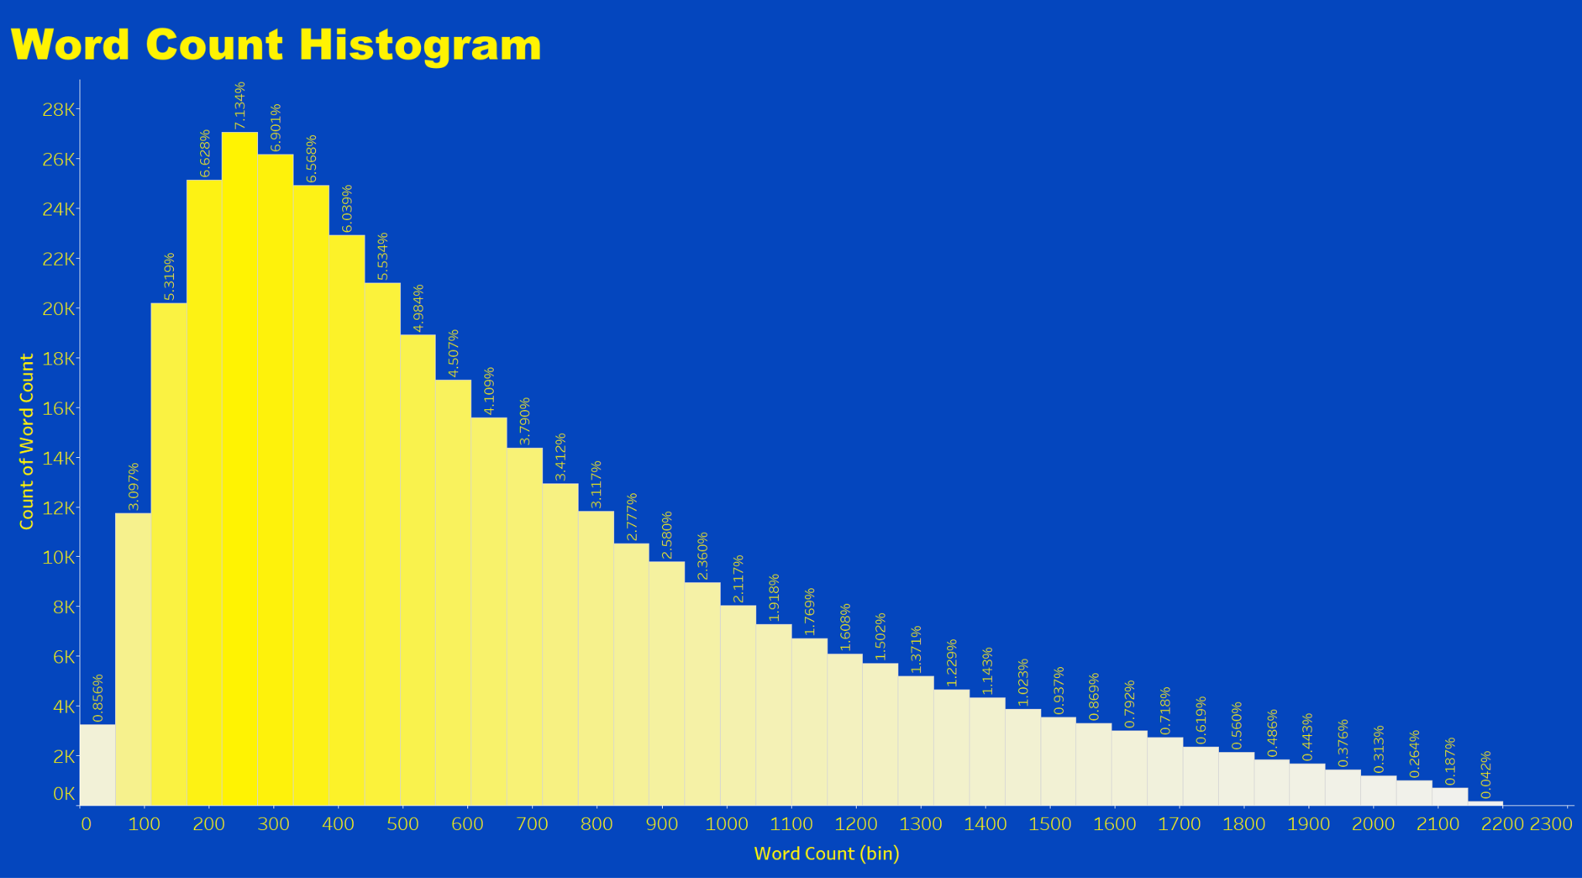

Exploratory Data Analysis: Words
01
Issue of extensive text
Average word count
02
Necessity
of text preprocessing
Data source: BEST BUY. Method, coding, and presentation: Data Lucipher Team.

Slide 5

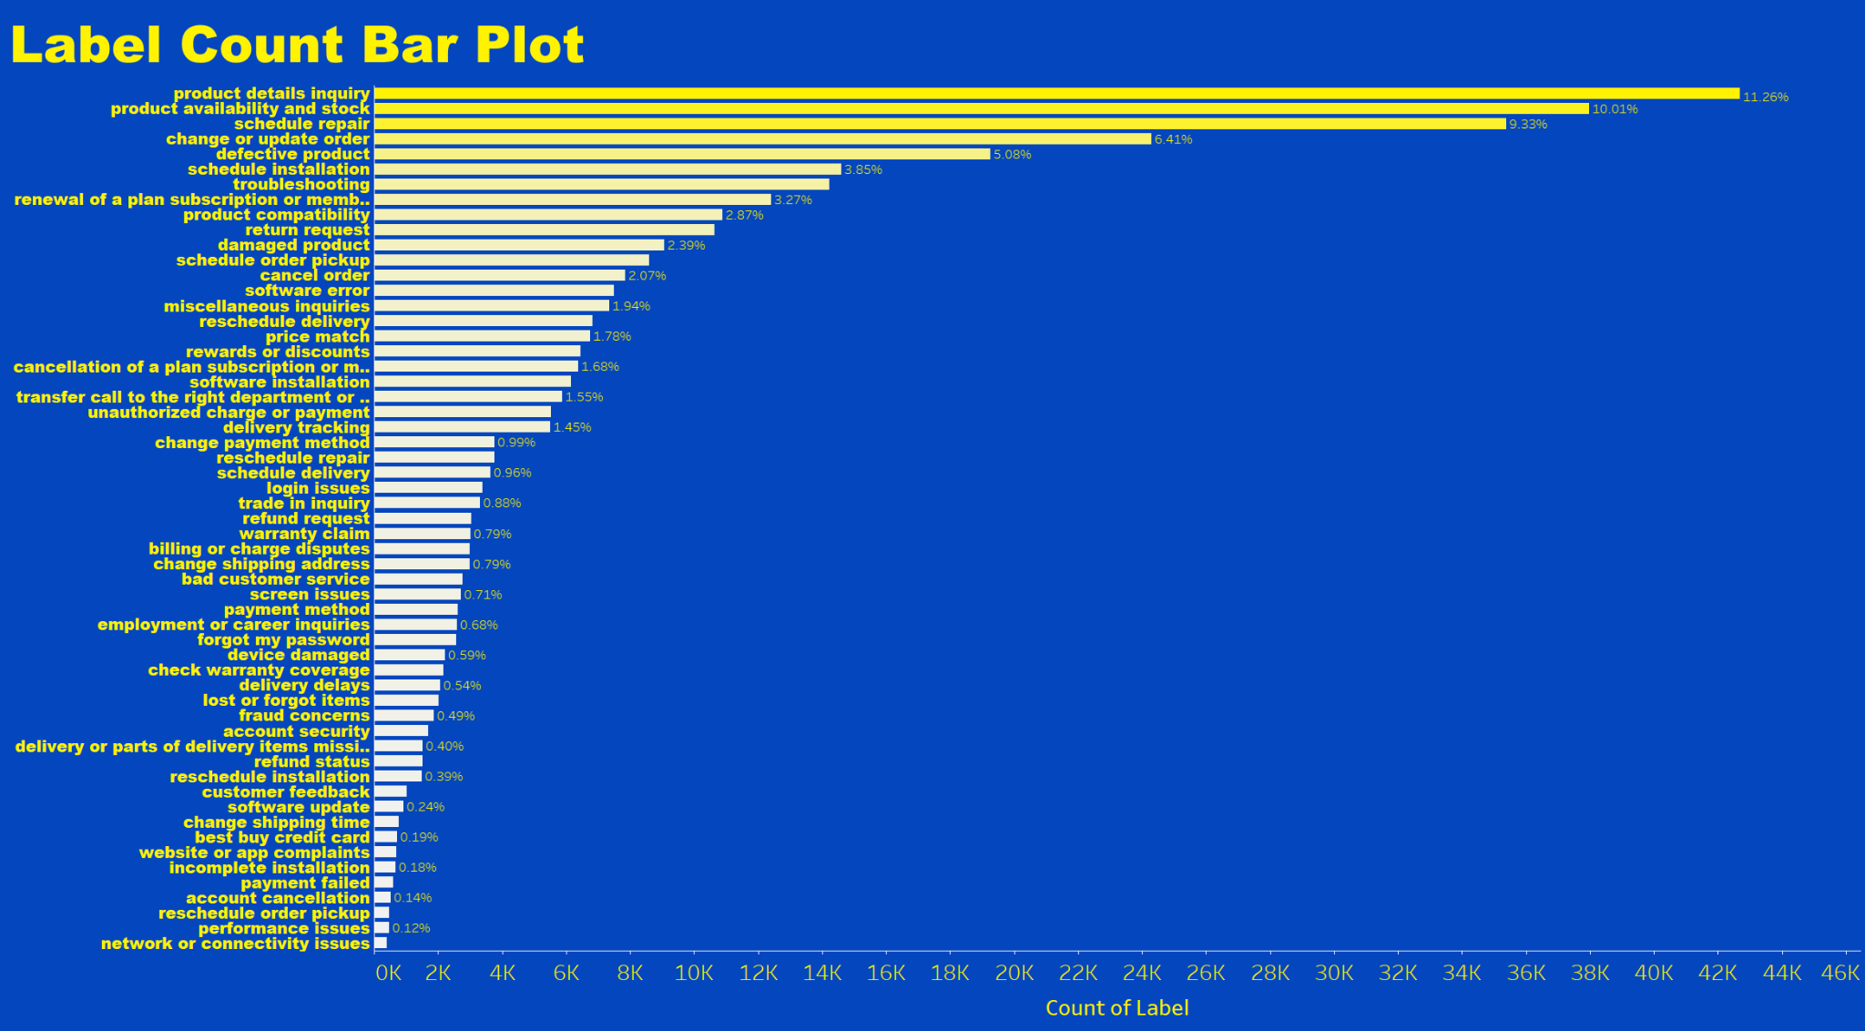
Exploratory Data Analysis: Labels
01
Sign of imbalanced data
02
Suggestion of using F1 score for model comparison
Data source: BEST BUY. Method, coding, and presentation: Data Lucipher Team.

Slide 6
Data Preprocessing
Seq2seq text summarization
Data source: BEST BUY. Method, coding, and presentation: Data Lucipher Team.

Slide 7
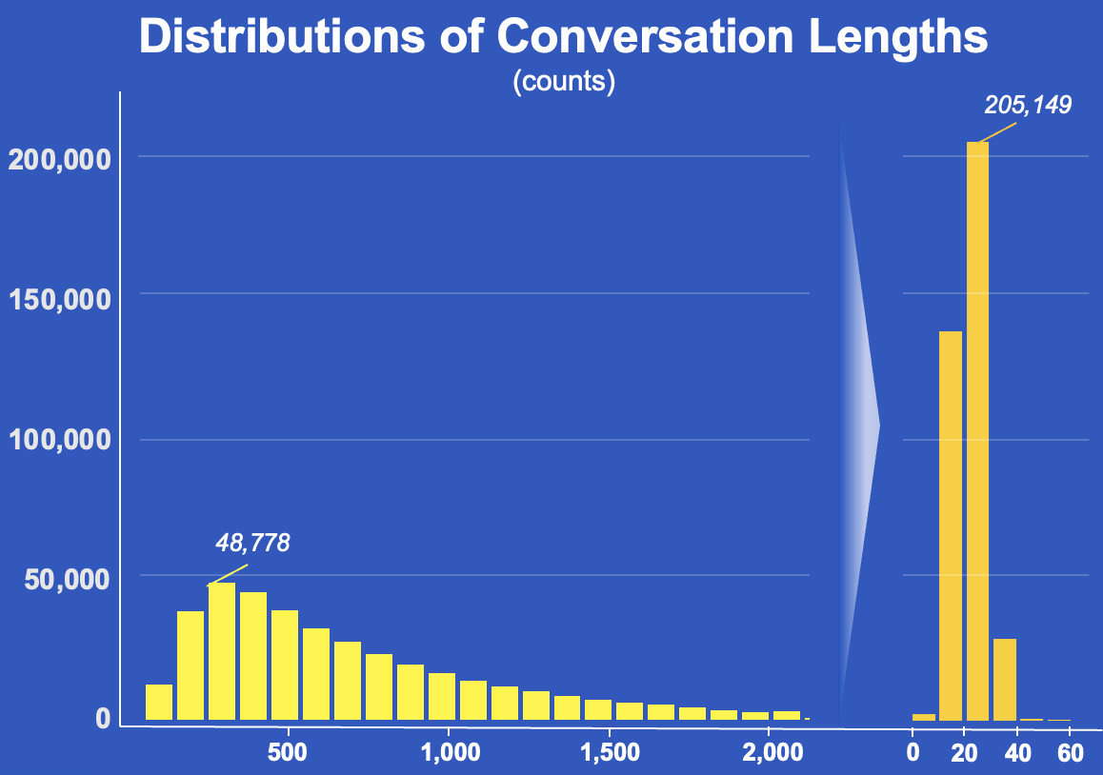
Data Preprocessing: Facebook.bart.xsum
After Summarization
Average Length
Conversation words have been reduced from 638.88 to 22.58
Text Format
Typos, improper punctuation, and wrong structure have been solved
Information Retention
Redundant sentences and words have been removed to ensure clarity and conciseness
Data source: BEST BUY. Method, coding, and presentation: Data Lucipher Team.

Slide 8
Data Preprocessing: Facebook.bart.xsum
Raw Data redundant and useless information and typos, adding to modeling difficulty
After Summarization
“agent says for contacting best buy this is name before we get started may i please have your phone number and full name in case or call the disconnected..customer says sure xxx.customer says xxxxxxx.agent says i appreciate it and may i please also have your name..customer says name..agent says thank you so much name for that important information let me know how can i help you..customer says um i recently just purchased a time for the uh ring doorbell i had it installed date from my parents..agent says okay..customer says they needed the actual time i just plugged it into the wall we paired it. its ringing on my phone but its not ringing in the house when i hit the doorbell.customer says so how do we what how do we get it the test worked we the the chime and the the plugged in chime does work but.customer says it it. it worked for the test when we did the test but it doesn't work when i hit the doorbell.agent says mm okay thank you. okay thank you so much for letting us know well. i need to connect you over to one of our technician..customer says okay great. thank you..customer says yep..agent says um and they will be able to guide you to make it ring okay. please stay on the line. i appreciate it..customer says you think if you.“
Average Length
Conversation words have been reduced from 638.88 to 22.58
Text Format
Typos, improper punctuation, and wrong structure have been solved
Summary clean, concise, efficient for modeling
Information Retention
Redundant sentences and words have been removed to ensure clarity and conciseness
“A customer called best buy had a problem with their doorbell, so they sent a technician to help her out.”

Slide 9
Data Preprocessing: Facebook.bart.xsum
Raw Data redundant and useless information and typos, adding to modeling difficulty
After Summarization
“agent says for contacting best buy this is name before we get started may i please have your phone number and full name in case or call the disconnected..customer says sure xxx.customer says xxxxxxx.agent says i appreciate it and may i please also have your name..customer says name..agent says thank you so much name for that important information let me know how can i help you..customer says um i recently just purchased a time for the uh ring doorbell i had it installed date from my parents..agent says okay..customer says they needed the actual time i just plugged it into the wall we paired it. its ringing on my phone but its not ringing in the house when i hit the doorbell.customer says so how do we what how do we get it the test worked we the the chime and the the plugged in chime does work but.customer says it it. it worked for the test when we did the test but it doesn't work when i hit the doorbell.agent says mm okay thank you. okay thank you so much for letting us know well. i need to connect you over to one of our technician..customer says okay great. thank you..customer says yep..agent says um and they will be able to guide you to make it ring okay. please stay on the line. i appreciate it..customer says you think if you.“
Average Length
Conversation words have been reduced from 638.88 to 22.58
Text Format
Typos, improper punctuation, and wrong structure have been solved
Summary clean, concise, efficient for modeling
Information Retention
Redundant sentences and words have been removed to ensure clarity and conciseness
“A customer called best buy had a problem with their doorbell, so they sent a technician to help her out.”

Slide 10
Data Preprocessing: Facebook.bart.xsum
Raw Data redundant and useless information and typos, adding to modeling difficulty
After Summarization
“agent says for contacting best buy this is name before we get started may i please have your phone number and full name in case or call the disconnected..customer says sure xxx.customer says xxxxxxx.agent says i appreciate it and may i please also have your name..customer says name..agent says thank you so much name for that important information let me know how can i help you..customer says um i recently just purchased a time for the uh ring doorbell i had it installed date from my parents..agent says okay..customer says they needed the actual time i just plugged it into the wall we paired it. its ringing on my phone but its not ringing in the house when i hit the doorbell.customer says so how do we what how do we get it the test worked we the the chime and the the plugged in chime does work but.customer says it it. it worked for the test when we did the test but it doesn't work when i hit the doorbell.agent says mm okay thank you. okay thank you so much for letting us know well. i need to connect you over to one of our technician..customer says okay great. thank you..customer says yep..agent says um and they will be able to guide you to make it ring okay. please stay on the line. i appreciate it..customer says you think if you.“
Average Length
Conversation words have been reduced from 638.88 to 22.58
Text Format
Typos, improper punctuation, and wrong structure have been solved
Summary clean, concise, efficient for modeling
Information Retention
Redundant sentences and words have been removed to ensure clarity and conciseness
“A customer called best buy had a problem with their doorbell, so they sent a technician to help her out.”

Slide 11
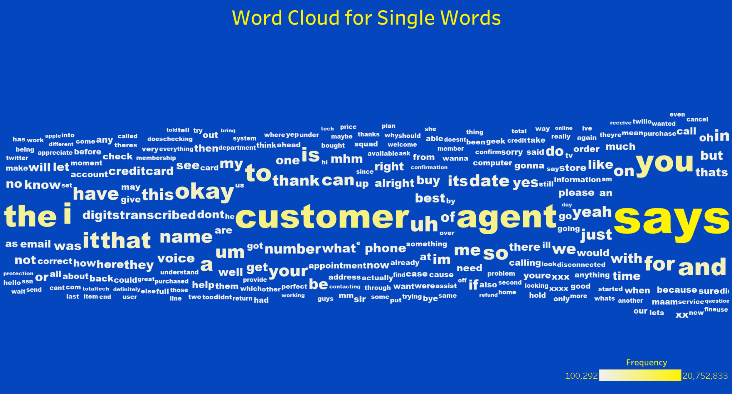
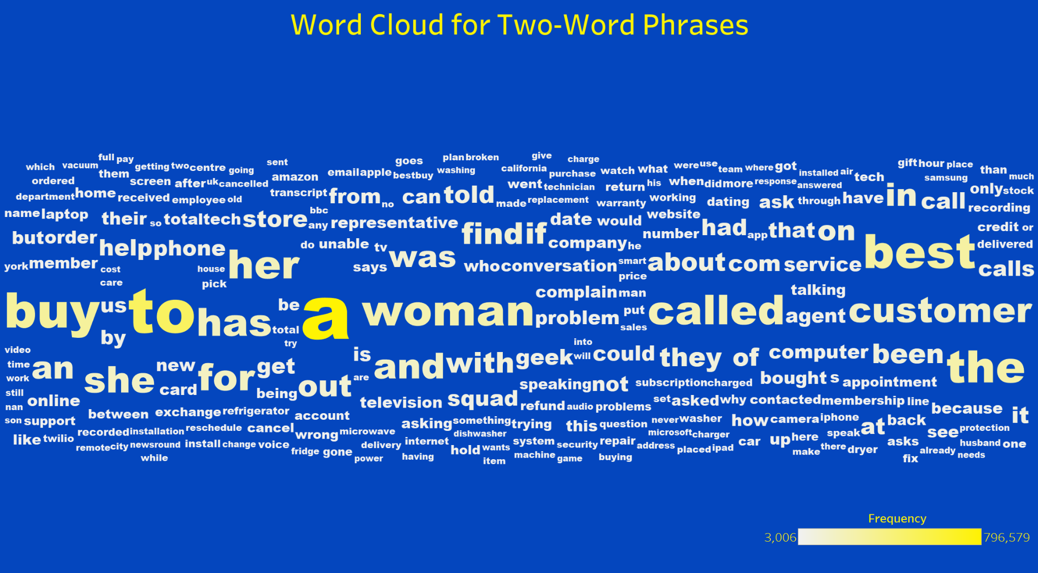
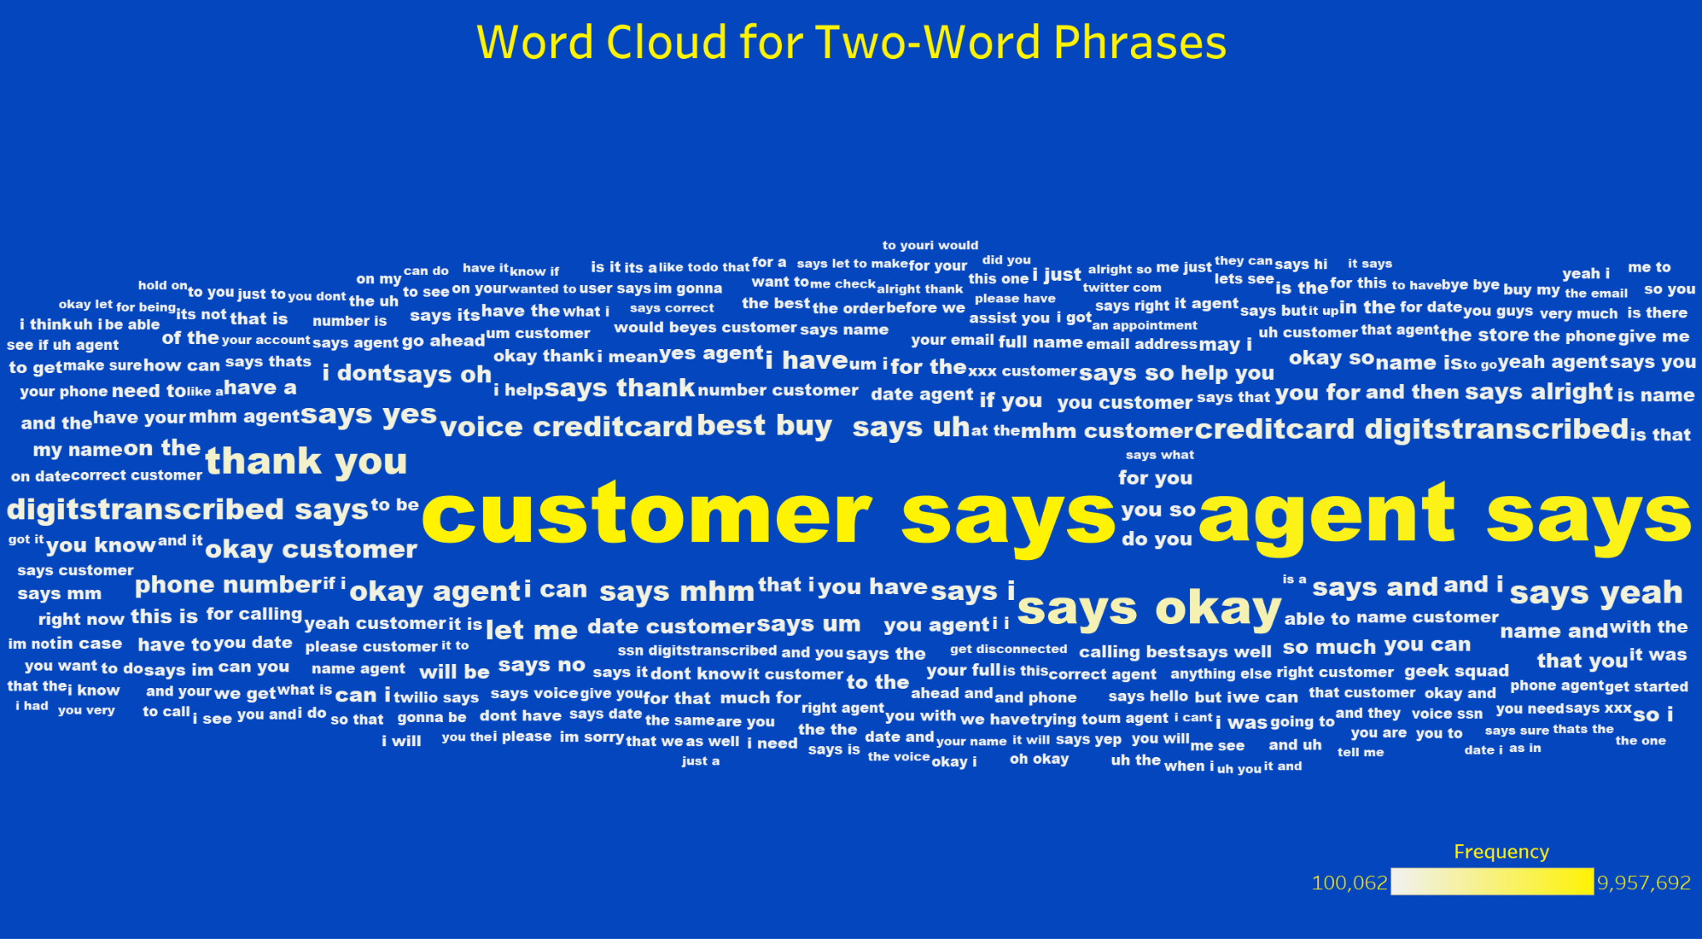
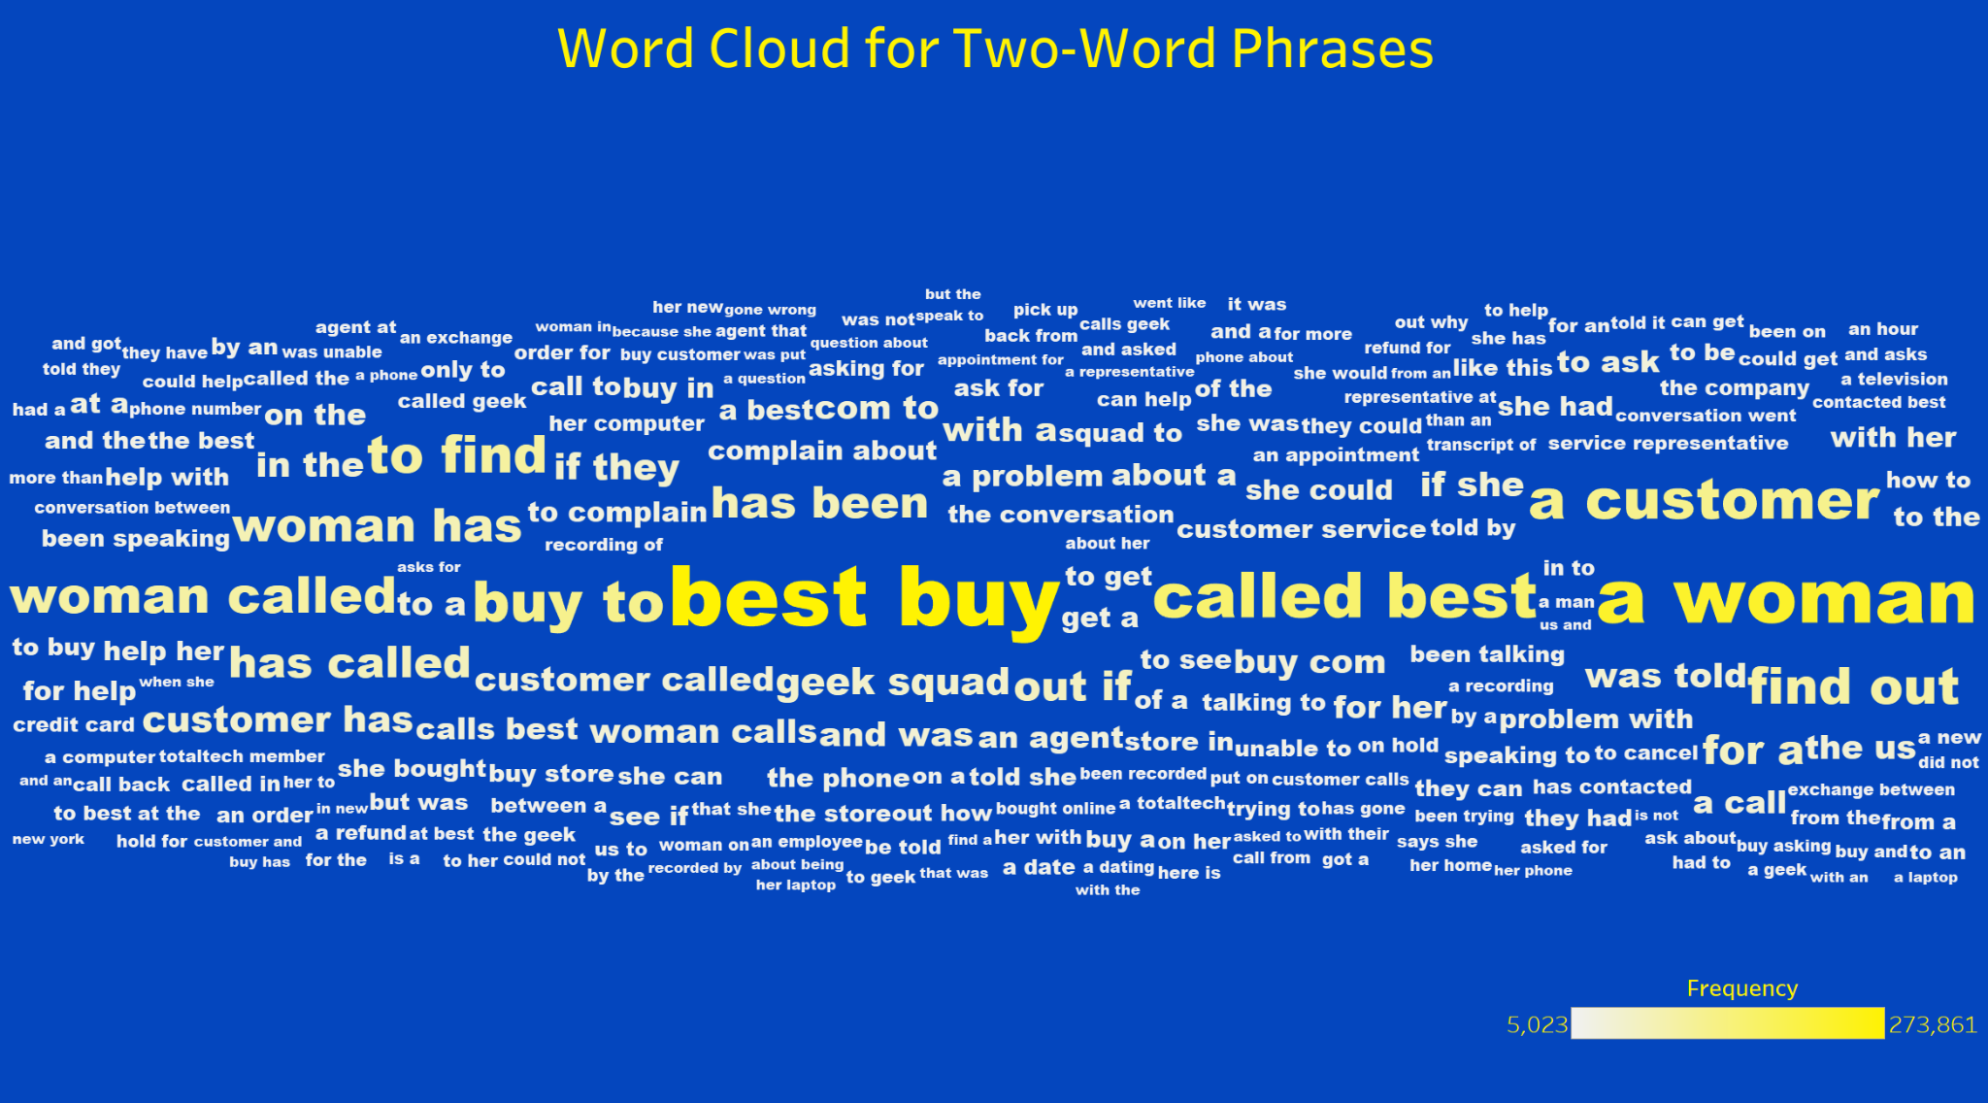
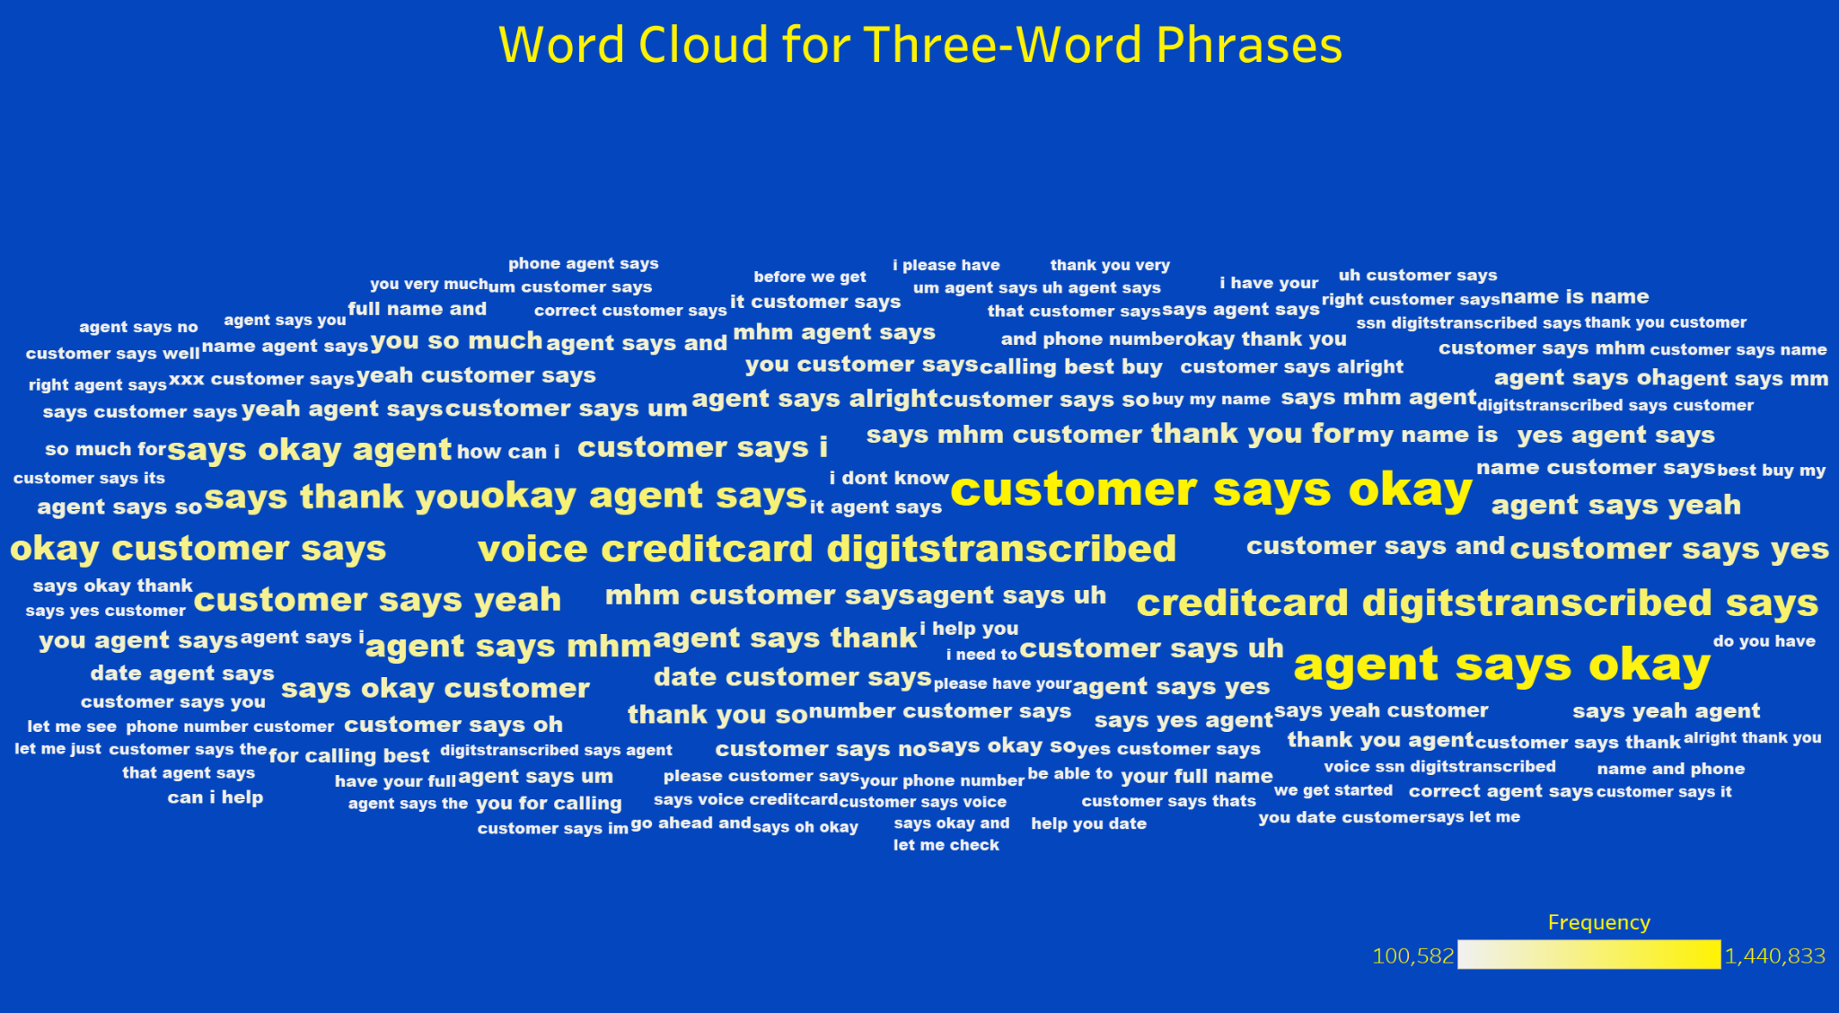
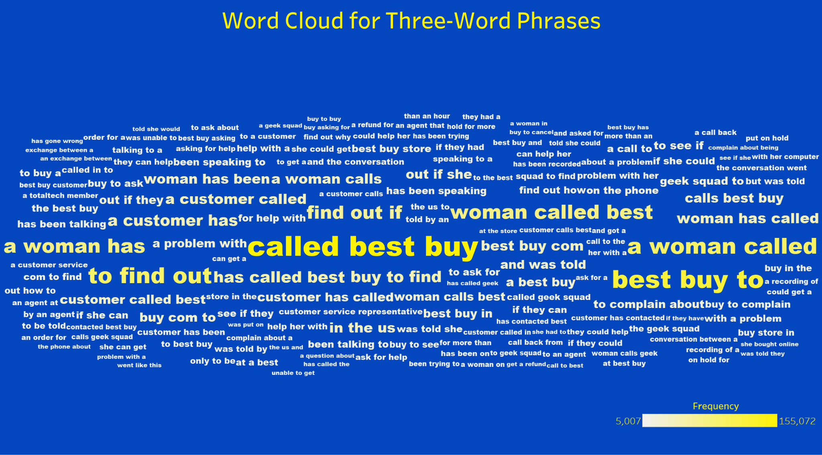
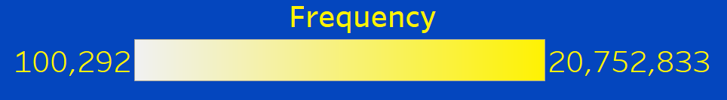
Data Preprocessing: Facebook.bart.xsum
Single Word
After Summarization
Average Length
Conversation words have been reduced from 638.88 to 22.58
Two-Word Phrases
Text Format
Typos, improper punctuation, and wrong structure have been solved
Three-Word Phrases
Information Retention
Redundant sentences and words have been removed to ensure clarity and conciseness
Data source: BEST BUY. Method, coding, and presentation: Data Lucipher Team.

Slide 12
Data Modeling:
Tokenization, Imbalanced Data, Albert
Data source: BEST BUY. Method, coding, and presentation: Data Lucipher Team.

Slide 13
Data Modeling: Tokenization
Assign Class Weights
LSTM
F1-Score
Run time
Model Evaluation
Handling
Imbalanced
Data
Data Preprocessing
Modeling
F1-Score
Run time
Model Evaluation
BERT
Resampling
Data source: BEST BUY. Method, coding, and presentation: Data Lucipher Team.

Slide 14
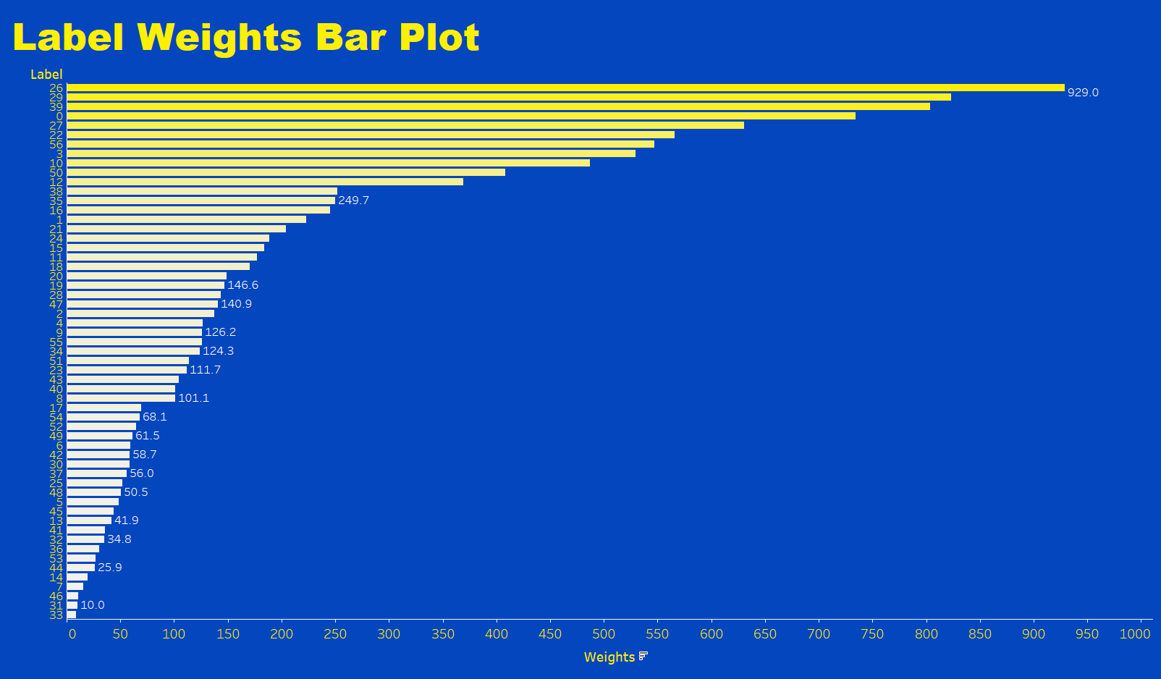


Modeling: Imbalanced Data
1
Assign Class Weights
2
Resampling Labels
Assign class weights does not work well for Albert
Balance Class Distribution
Better Learning of Minority Class
Simplicity and computational efficiency
Set threshold to 5,000
$$ω_{i}=\frac{Σ_{m= 1}^{57}N_{m}}{N_{i}}$$
Set threshold to 10,000
$ω_{i}$ : the weight of class i
$N_{i}$ : the number of text in class i
Set threshold to 15,000
Data source: BEST BUY. Method, coding, and presentation: Data Lucipher Team.
Notes:
BERT's Pre-training: The extensive pre-training on diverse and large datasets may make BERT models less sensitive to class imbalances in specific training datasets. They might not respond as effectively to label weighting as a method for addressing class imbalance.
Smaller BERT Models: A smaller BERT model has fewer parameters and may not capture the nuances required to effectively leverage label weights for minority classes, especially in complex tasks like text classification.

Slide 15

Modeling: Imbalanced Data
1
Assign Class Weights
2
Resampling Labels
Assign class weights does not work well for Albert
Balance Class Distribution
Better Learning of Minority Class
Simplicity and computational efficiency
$$ω_{i}=\frac{Σ_{m= 1}^{57}N_{m}}{N_{i}}$$
Set threshold to 5,000
478,985 text
$ω_{i}$ : the weight of class i
$N_{i}$ : the number of text in class i
Data source: BEST BUY. Method, coding, and presentation: Data Lucipher Team.
Notes:
BERT's Pre-training: The extensive pre-training on diverse and large datasets may make BERT models less sensitive to class imbalances in specific training datasets. They might not respond as effectively to label weighting as a method for addressing class imbalance.
Smaller BERT Models: A smaller BERT model has fewer parameters and may not capture the nuances required to effectively leverage label weights for minority classes, especially in complex tasks like text classification.

Slide 16
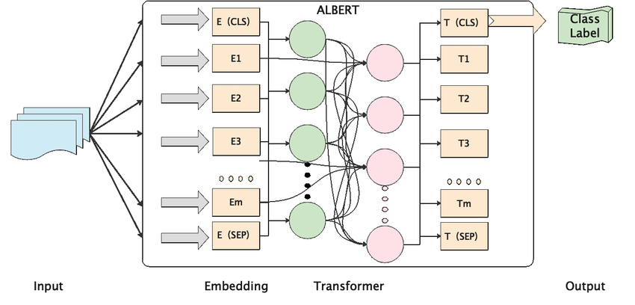
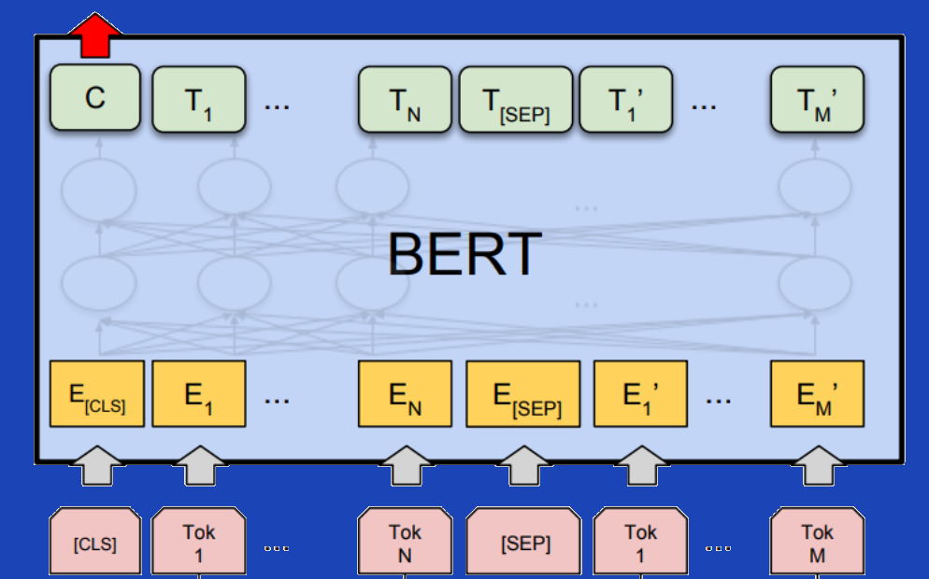
Modeling: From Bert to Albert
Bert-based-uncased model
A-little-bert model
Class
Label
rewards or discounts
RNN
usually sees the words one after the other
GPT
internally masks the future tokens
BERT
allows the model to learn a bidirectional representation of the sentence
Model | Parameters | Layers | Hidden | Embedding
BERT | 108M | 12 | 768 | 768
ALBERT | 12M parameter sharing | 12 | 768 | 128
Sentence 1
Sentence 2
A woman has called best buy to ask if she can get a refund for a watch she bought on date and the cashier rang her up for the full lawn like my best buy total rewards membership thing.
Problem
Memory Issue
Low Accuracy
Solve the issue of training time exponentially increasing with the number of epochs
Improve the validation performance
Data source: BEST BUY. Method, coding, and presentation: Data Lucipher Team.

Slide 17
Model Training & Evaluation:
Albert & LSTM
Data source: BEST BUY. Method, coding, and presentation: Data Lucipher Team.

Slide 18
Model Training & Evaluation:
Albert
LSTM
Train
Valid
Test
Train
Valid
Test
64%
42%
45%
43%
36%
36%
F1
0.63
Accuracy
0.64
F1
0.42
Accuracy
0.42
F1
0.44
Accuracy
0.45
F1
0.42
Accuracy
0.43
F1
0.34
Accuracy
0.36
F1
0.35
Accuracy
0.36
Run Time
Run Time
7 Hours
1 Hours
Data source: BEST BUY. Method, coding, and presentation: Data Lucipher Team.

Slide 19
Business Analysis
SWOT Analysis & Business Strategy
Data source: BEST BUY. Method, coding, and presentation: Data Lucipher Team.

Slide 20
SWOT Analysis
Enhance BestBuy practical experience in labeling predictions
Assist BestBuy in resource allocation strategies and proactive problem-solving to stay ahead of challenges
Highly imbalanced data, hard for model to train
Over-Reliance on Automation
Strengths
Weaknesses
SW
OT
Opportunities
Threats
Provide better personalized customer service
Strategic partnership, enhancing bargaining power
Competitors
Data security
Data source: BEST BUY. Method, coding, and presentation: Data Lucipher Team.

Slide 21
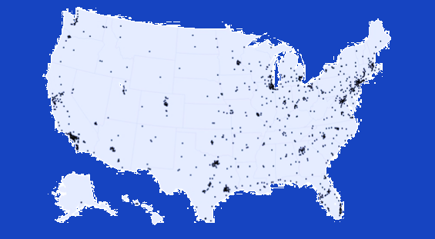
Business Strategy: Resource Allocation
“One-size-fits-all” model
"Geo-Targeted Retail ” model
1
Add location data to phone records enables us to identify problem areas
2
Tailor improvements to branches and logistics
All Best Buy locations
displayed on map 2023
3
Optimization based on location-specific issues
State | Locations | Percentage | Population Per Location
California | 143 | 13.8% | 276,491
Texas | 106 | 10.2% | 274,957
Florida | 65 | 6.3% | 331,356
New York | 53 | 5.1% | 381,429
Illinois | 44 | 4.2% | 291,193
Store Efficiency & Customer Satisfaction
Top 5 states with most Best Buy stores
Data source: BEST BUY. Method, coding, and presentation: Data Lucipher Team.
Notes:
BERT's Pre-training: The extensive pre-training on diverse and large datasets may make BERT models less sensitive to class imbalances in specific training datasets. They might not respond as effectively to label weighting as a method for addressing class imbalance.
Smaller BERT Models: A smaller BERT model has fewer parameters and may not capture the nuances required to effectively leverage label weights for minority classes, especially in complex tasks like text classification.

Slide 22

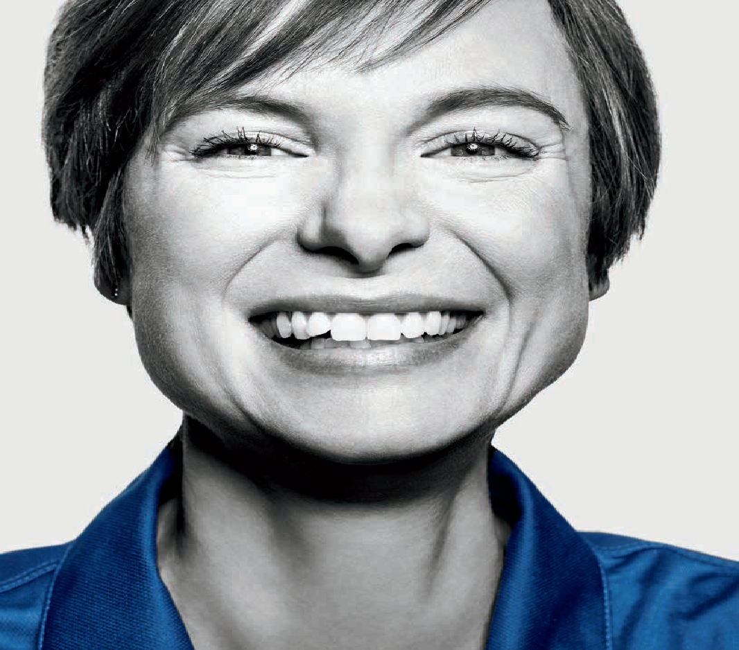
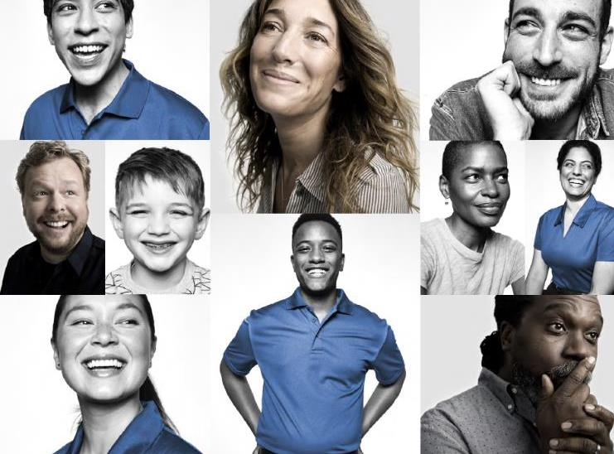
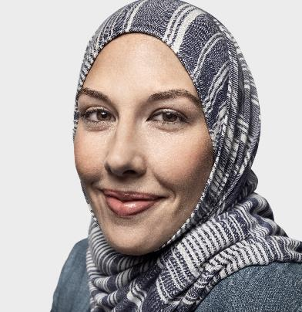
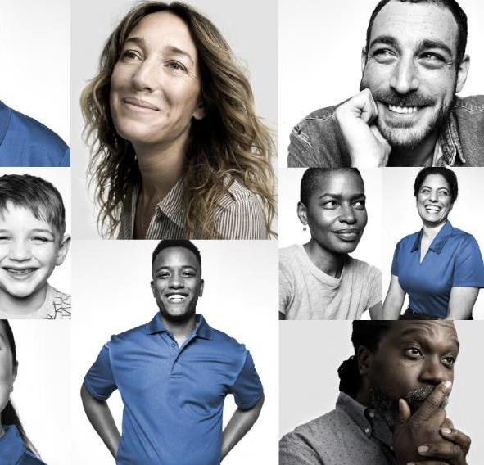
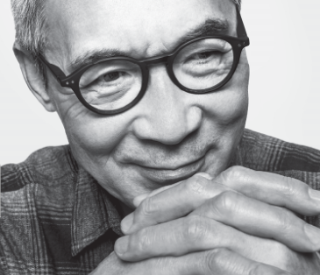

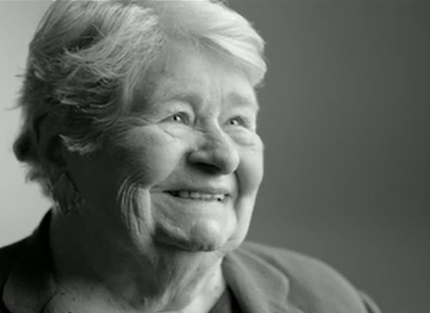

Thank you for the time
Most of our customers seem to be thoughtful go-getters, ambitious, active & social.
Technology excites them!
They buy across categories, channels and price points —
but they need & want help with technology.
22

